Slide 1

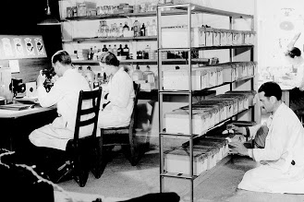
Bioinformatics
+
=
?
Presented by Theo N.

Slide 2



Foundation
Variability
DNA
RNA
Protein

Slide 3
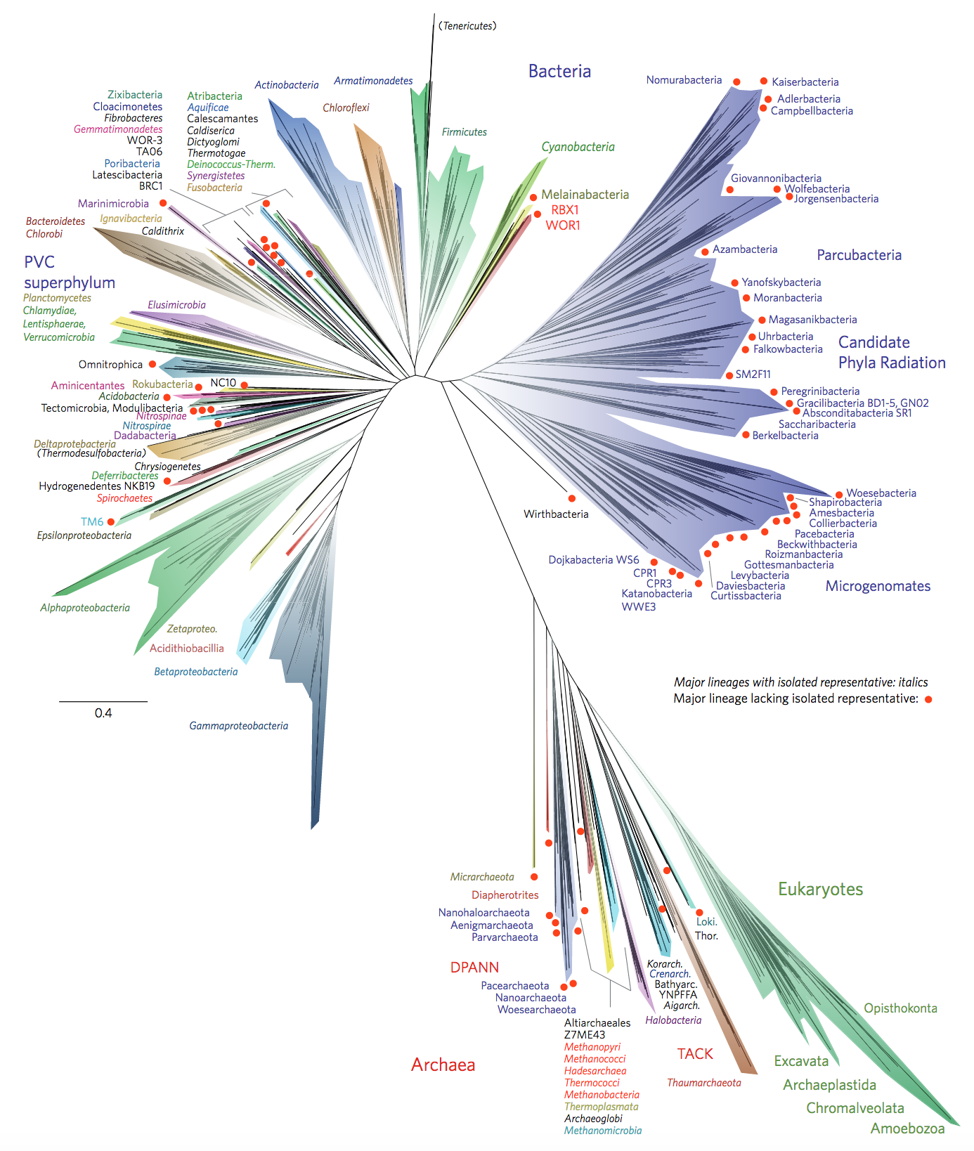
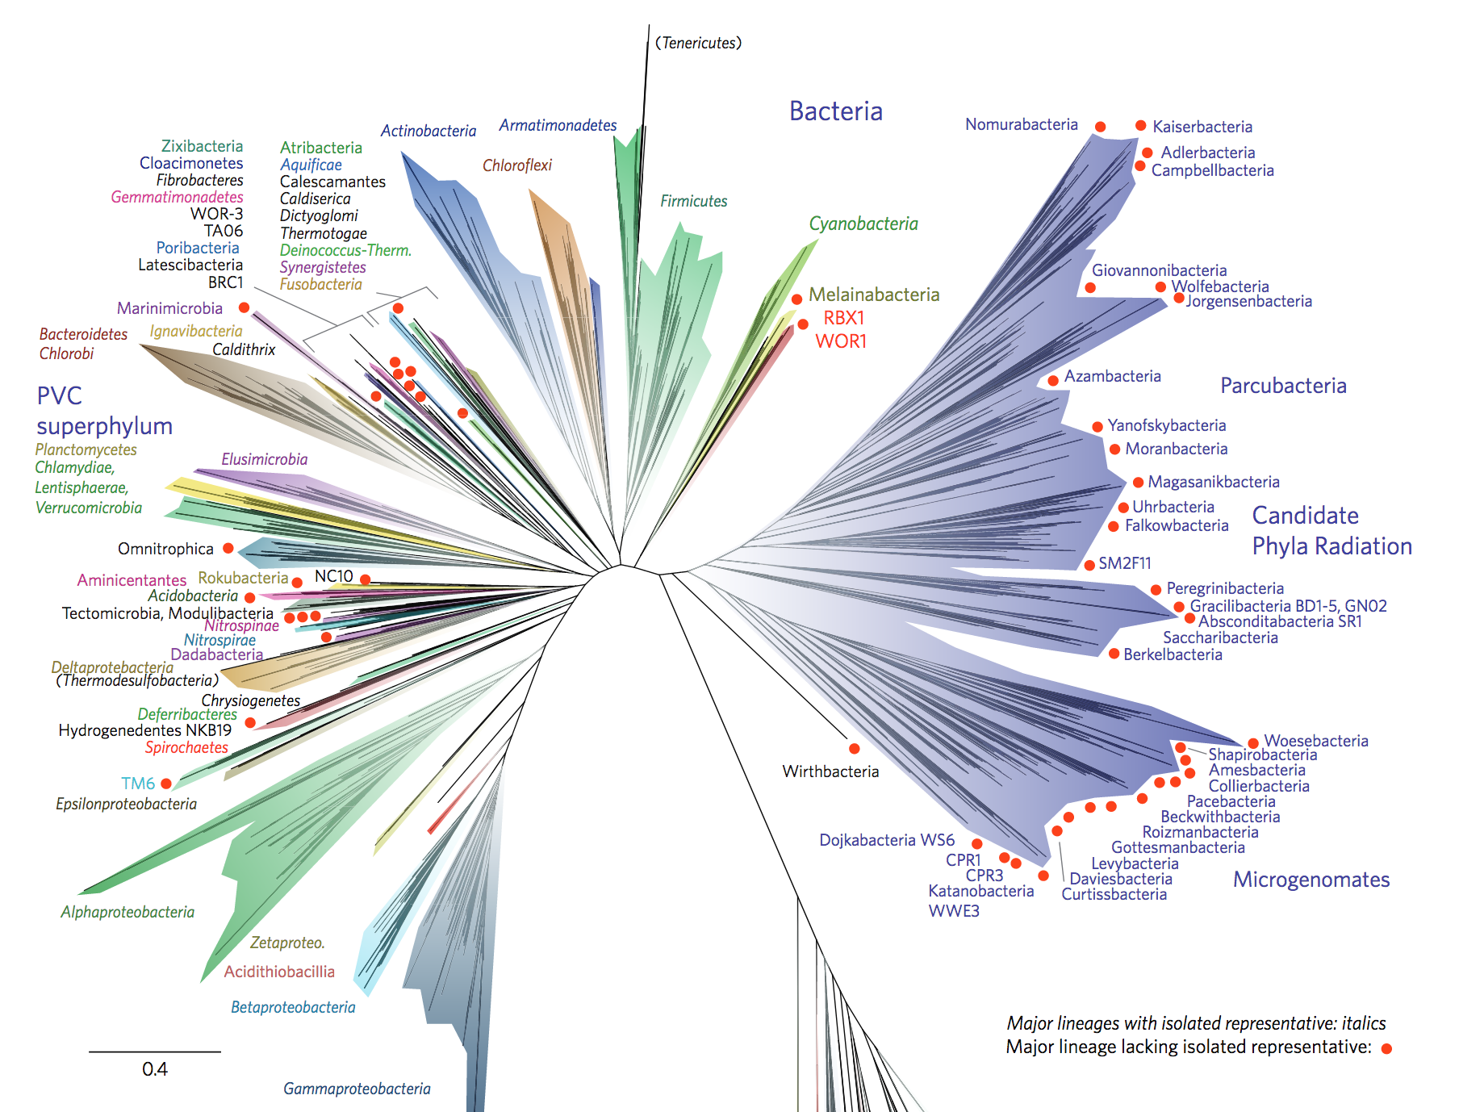
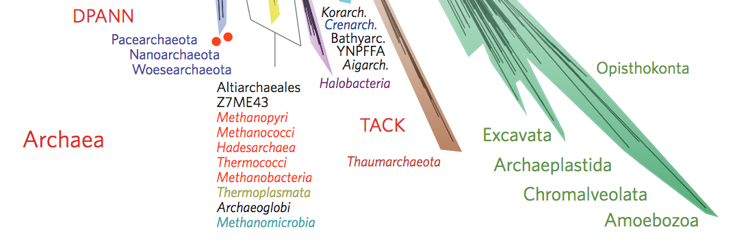
Significance
www.nature.com/articles/nmicrobiol201648.pdf

Slide 4
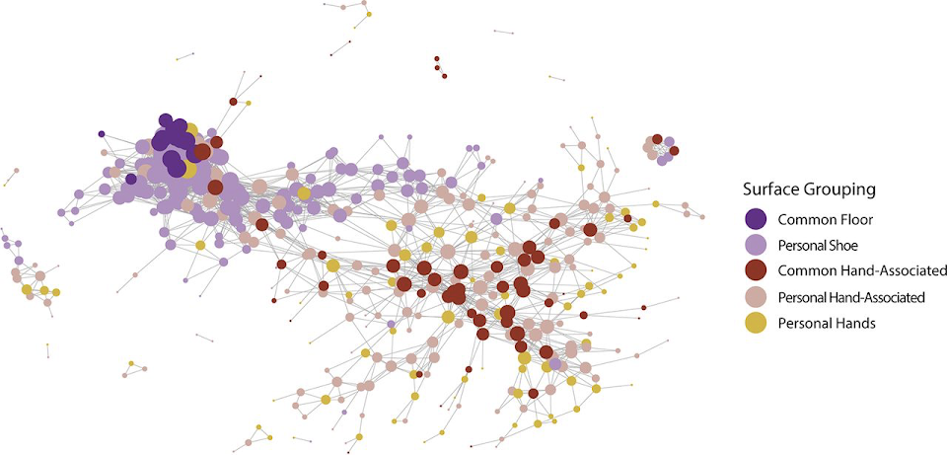
Significance - College Dorms
Microbial Similarity between Students in a Common Dormitory Environment Reveals the Forensic Potential of Individual Microbial Signatures
Miles Richardson, Neil Gottel, Jack A. Gilbert, Simon Lax
mBio Jul 2019, 10 (4) e01054-19; DOI: 10.1128/mBio.01054-19

Slide 5
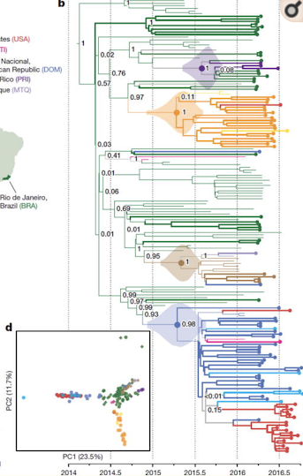
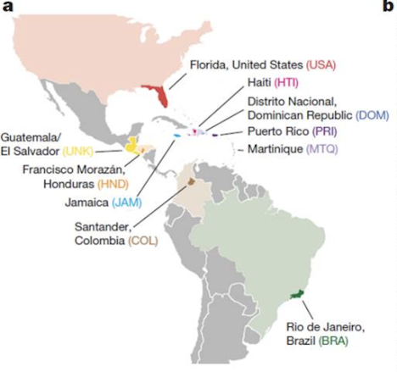
Significance - ZIKA
Metsky HC, Matranga CB, Wohl S, et al. Zika virus evolution and spread in the Americas. Nature. 2017;546(7658):411–415. doi:10.1038/nature22402

Slide 6
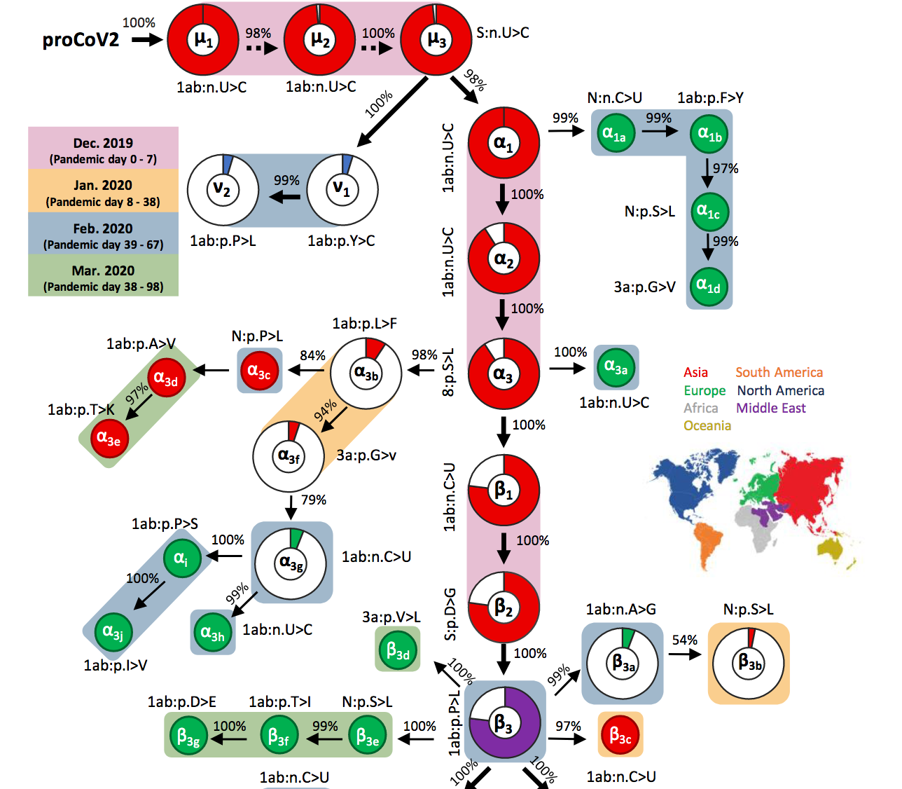

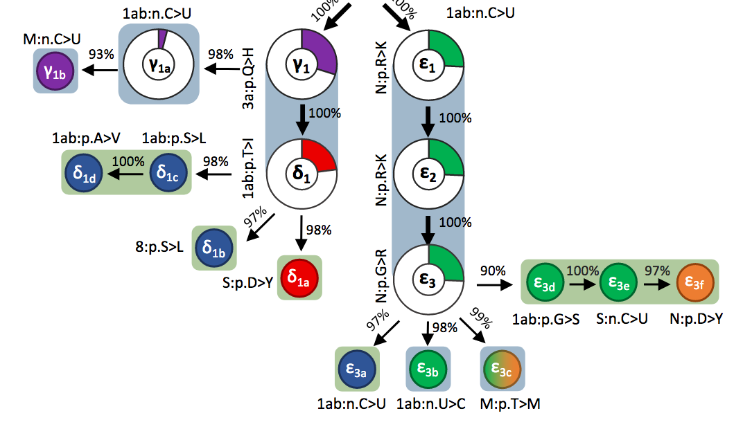
Significance – COVID19
An evolutionary portrait of the progenitor SARS-CoV-2 and its dominant offshoots in COVID-19 pandemic
Sudhir Kumar, Qiqing Tao, Steven Weaver, Maxwell Sanderford, Marcos A. Caraballo-Ortiz, Sudip Sharma, Sergei L. K. Pond, Sayaka Miura
bioRxiv 2020.09.24.311845; doi: https://doi.org/10.1101/2020.09.24.311845

Slide 7
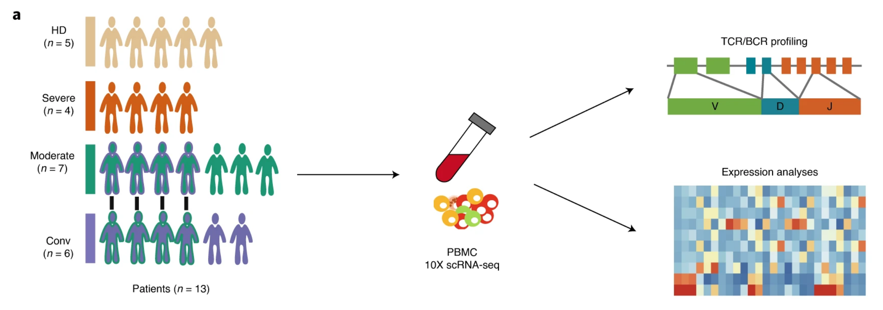
Significance – COVID19
Zhang, JY., Wang, XM., Xing, X. et al. Single-cell landscape of immunological responses in patients with COVID-19. Nat Immunol 21, 1107–1118 (2020). https://doi.org/10.1038/s41590-020-0762-x

Slide 8
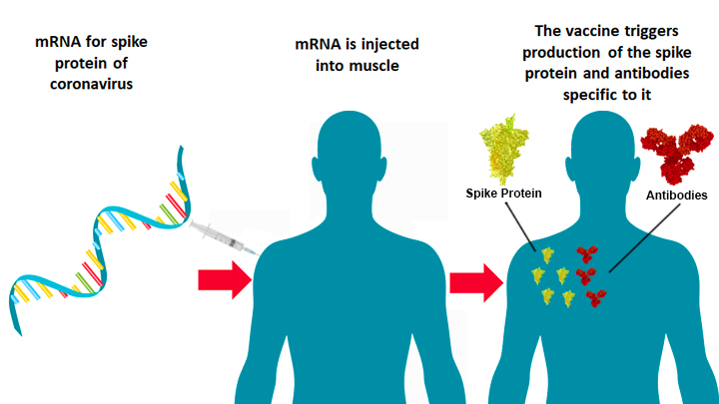
Significance – COVID19
https://directorsblog.nih.gov/2020/07/16/researchers-publish-encouraging-early-data-on-covid-19-vaccine/

Slide 9
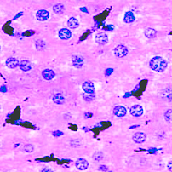
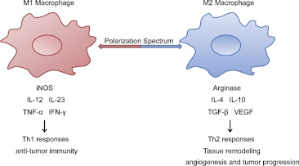
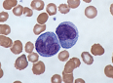
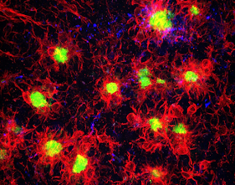
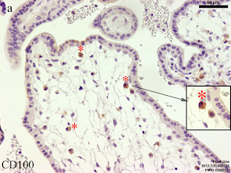
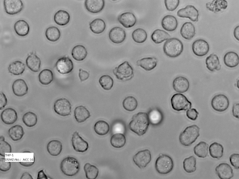
Monocytes
Kupffer
Decidual
Microglia
HBC
THP1

Slide 10
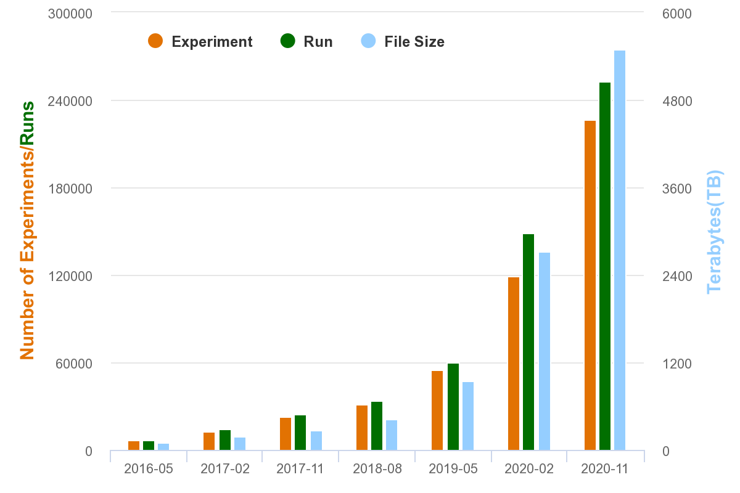
Exponential Data Increase

Slide 11
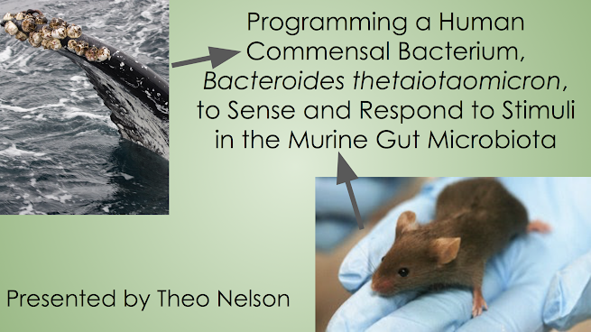
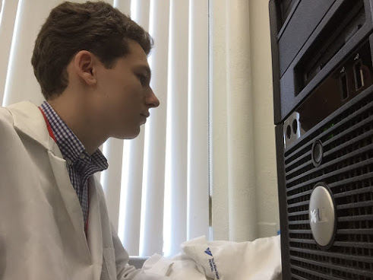
Computational Biology vs. Bioinformatics

Slide 12
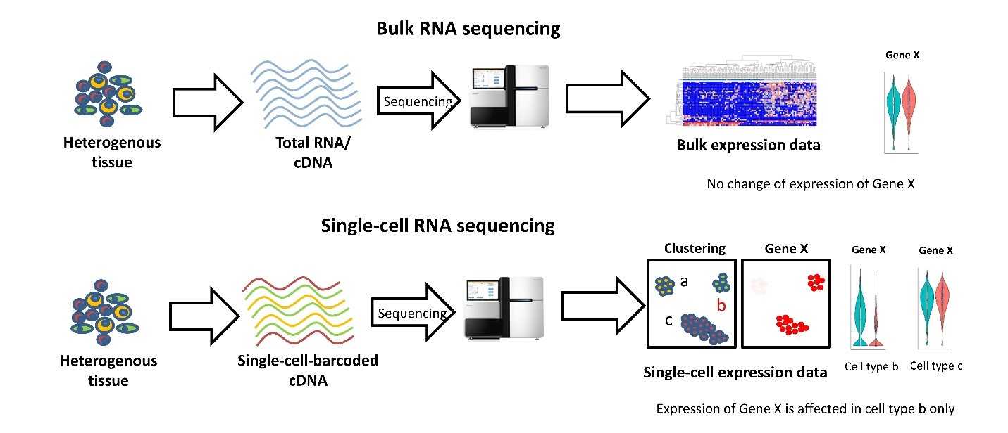
Bulk vs. sc RNAseq

Slide 13
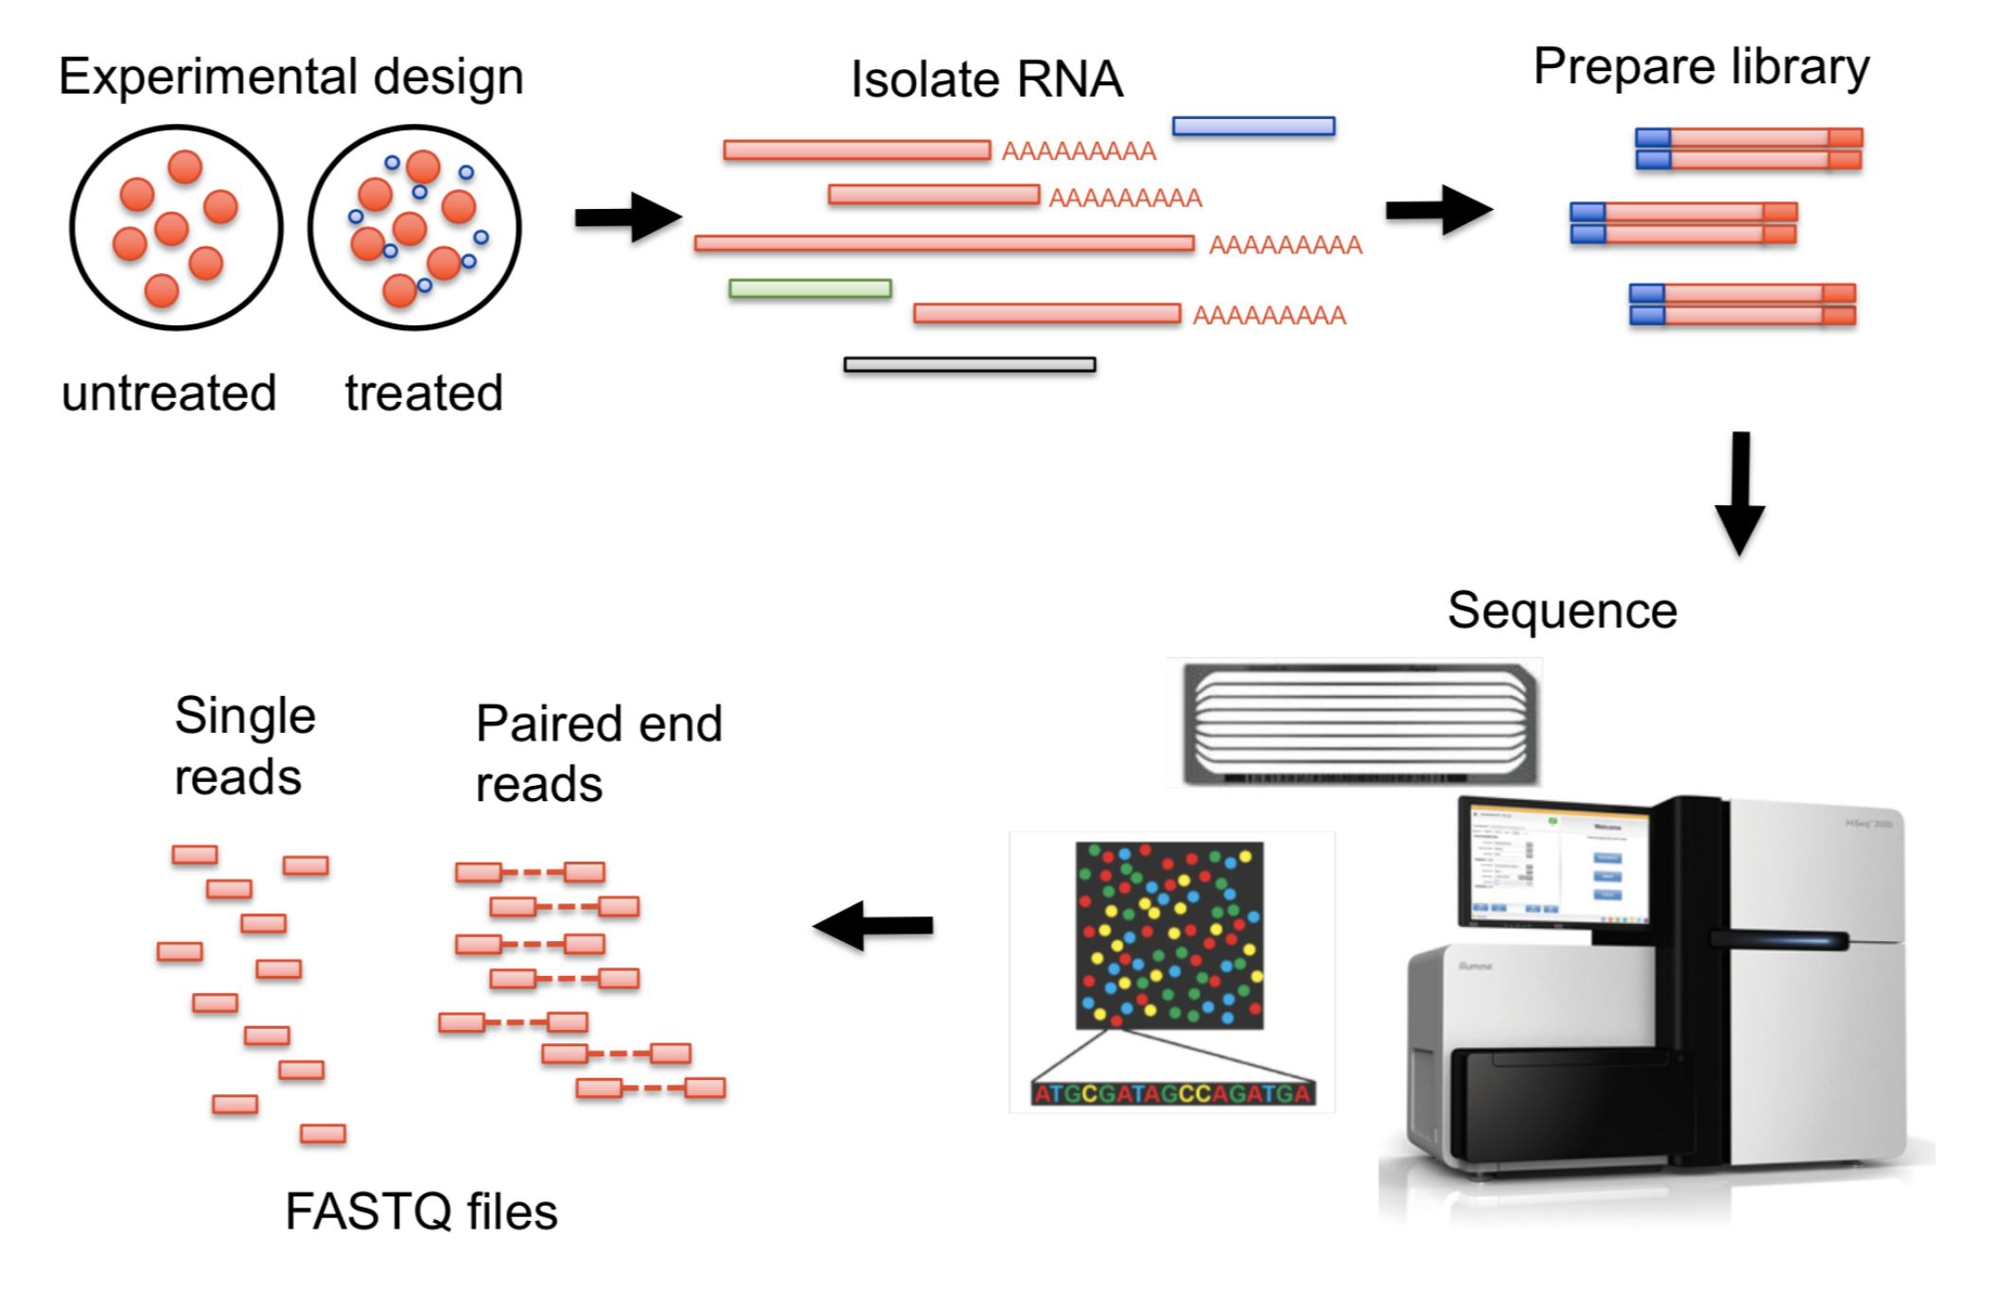
Experimental Design

Slide 14
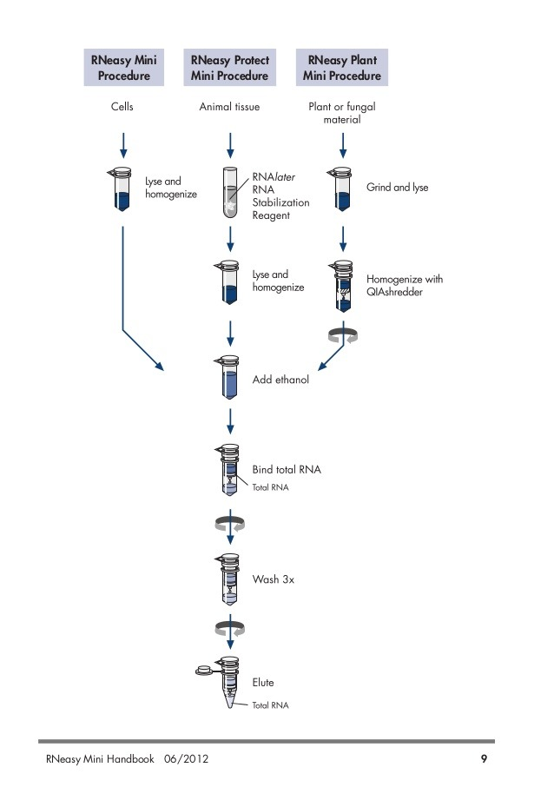
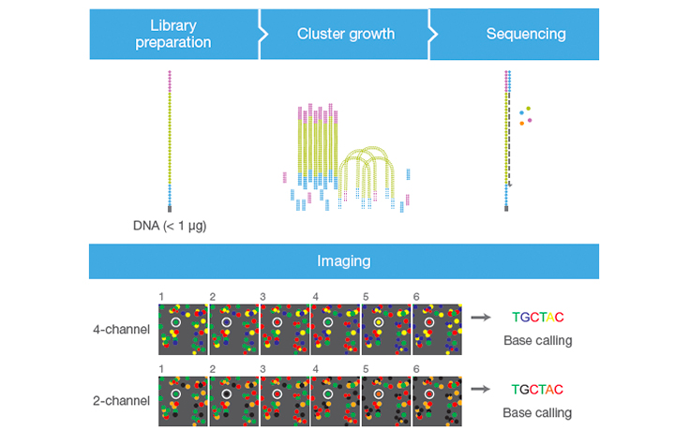
Data Collection Techniques

Slide 15
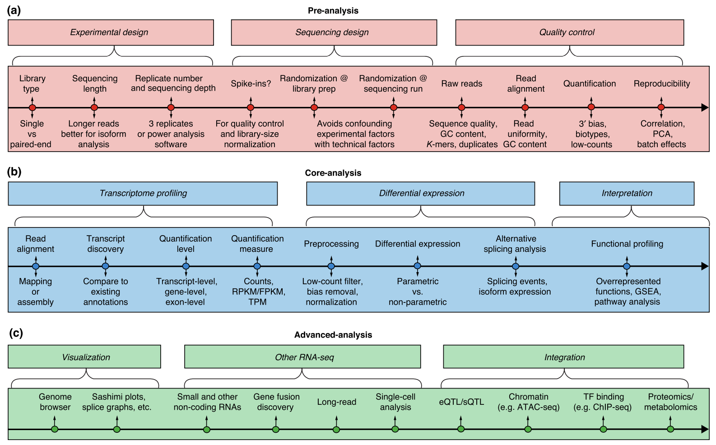

Slide 16







Slide 17
Questions?
tmn2126@columbia.edu

Slide 18
